Slide 1
Capstone Project
Topic Modeling on News Articles

Slide 2
Content
Problem Statement
Data Summary
Data Preprocessing
Models
Challenges
Conclusions
Q&A

Slide 3
Problem Statement
Identify major themes/topics across a collection of BBC news articles using Latent Dirichlet Allocation (LDA) and Latent Semantic Analysis (LSA).

Slide 4
Data Preprocessing
Remove duplicate values
Remove Html tags
Remove URLs
Remove punctuation
Remove numbers
Remove small length words
Remove stop words
Lemmatization

Slide 5
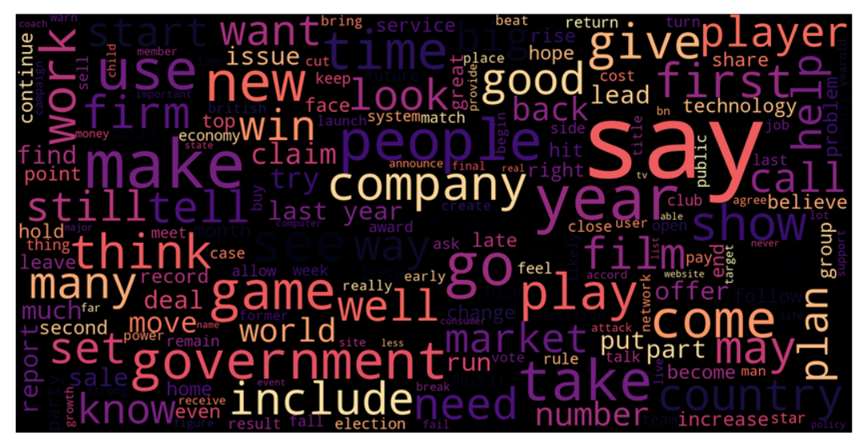
Word Cloud

Slide 6
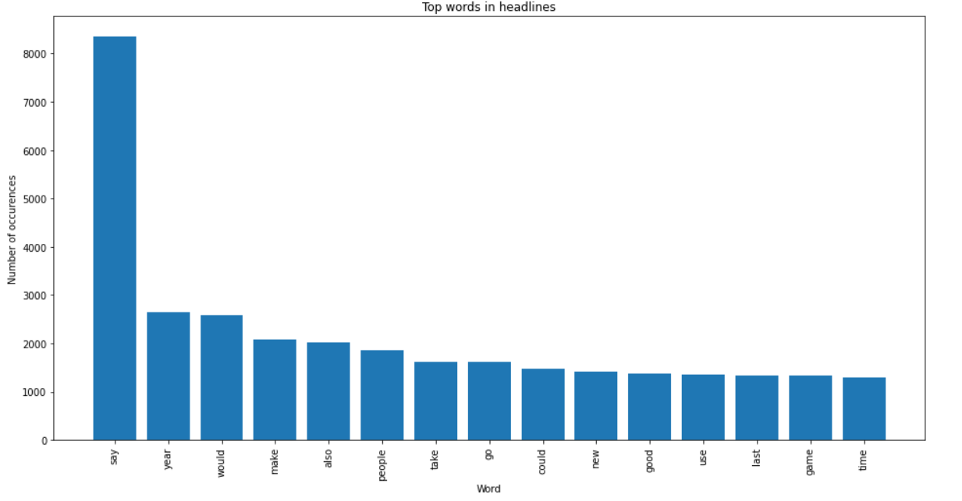
Frequent words

Slide 7
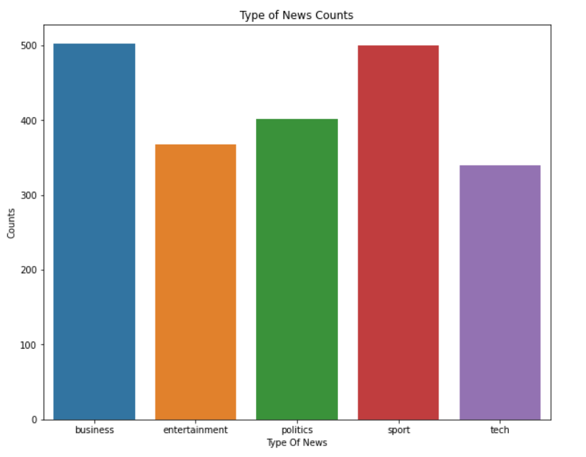
Countplot of News Types

Slide 8
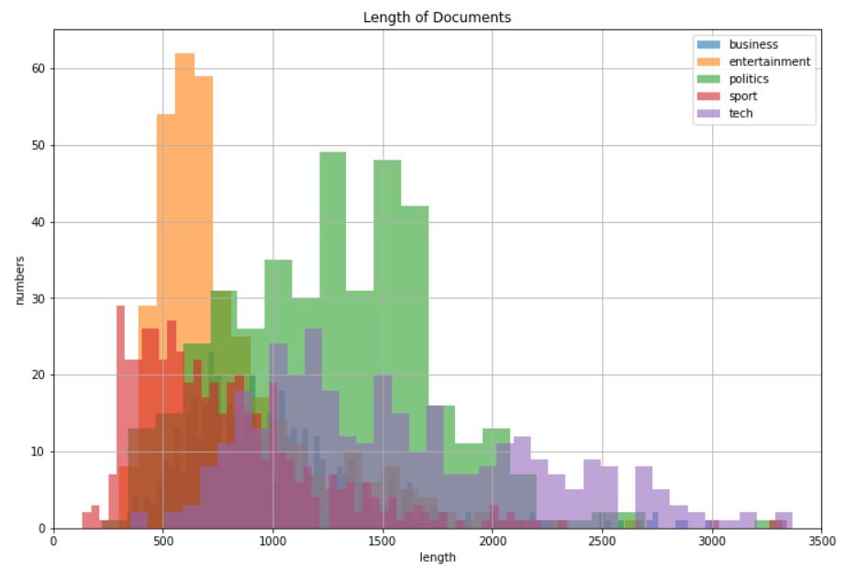
Length of Documents

Slide 9
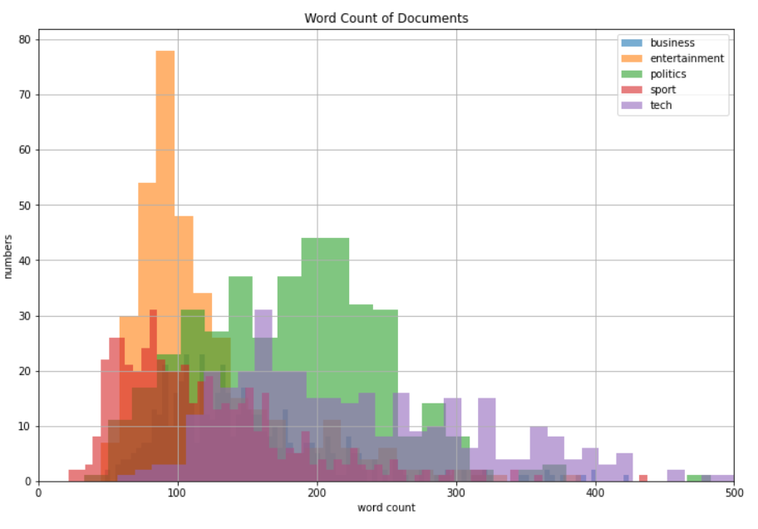
Word Count of Documents

Slide 10
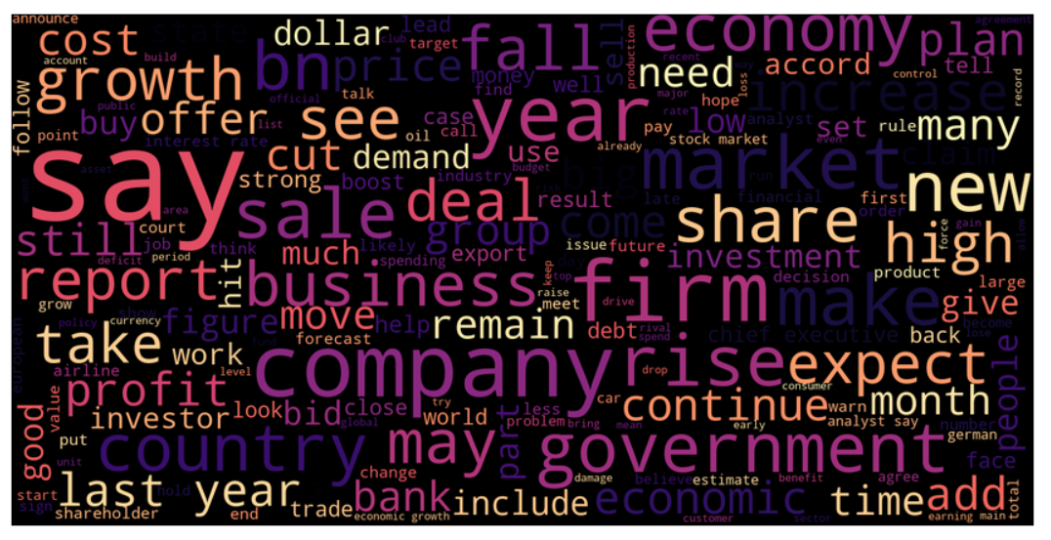
Word Cloud for Business

Slide 11
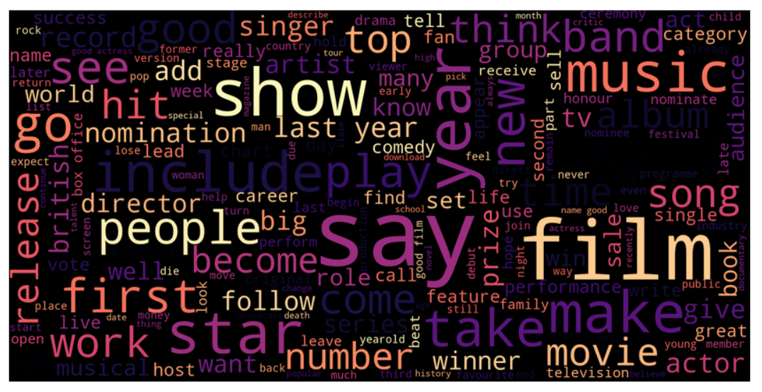
Word Cloud for Entertainment

Slide 12
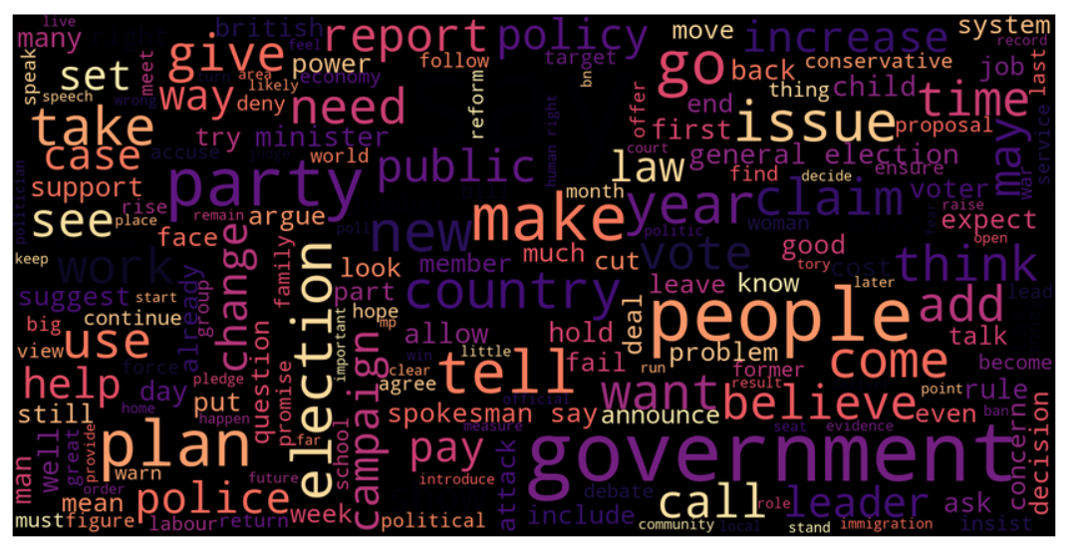
Word Cloud for Politics

Slide 13
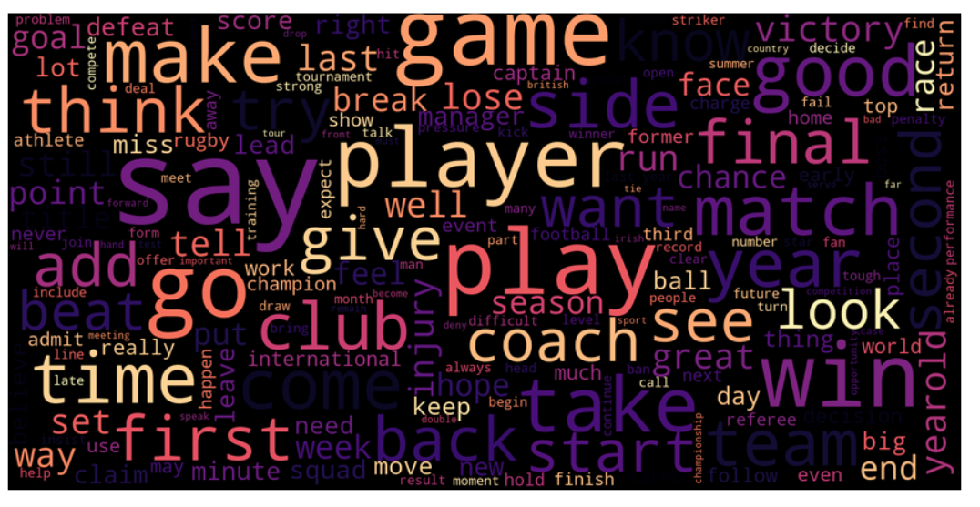
Word Cloud for Sport

Slide 14
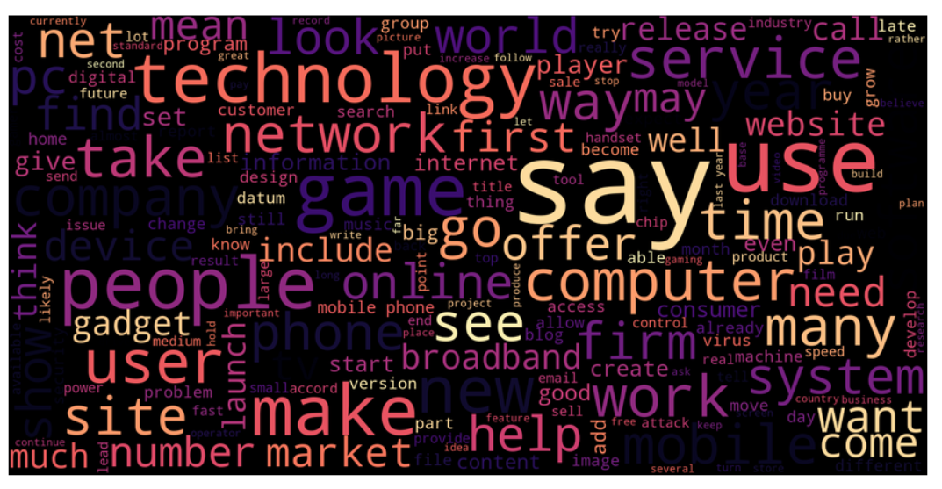
Word Cloud for Tech

Slide 15
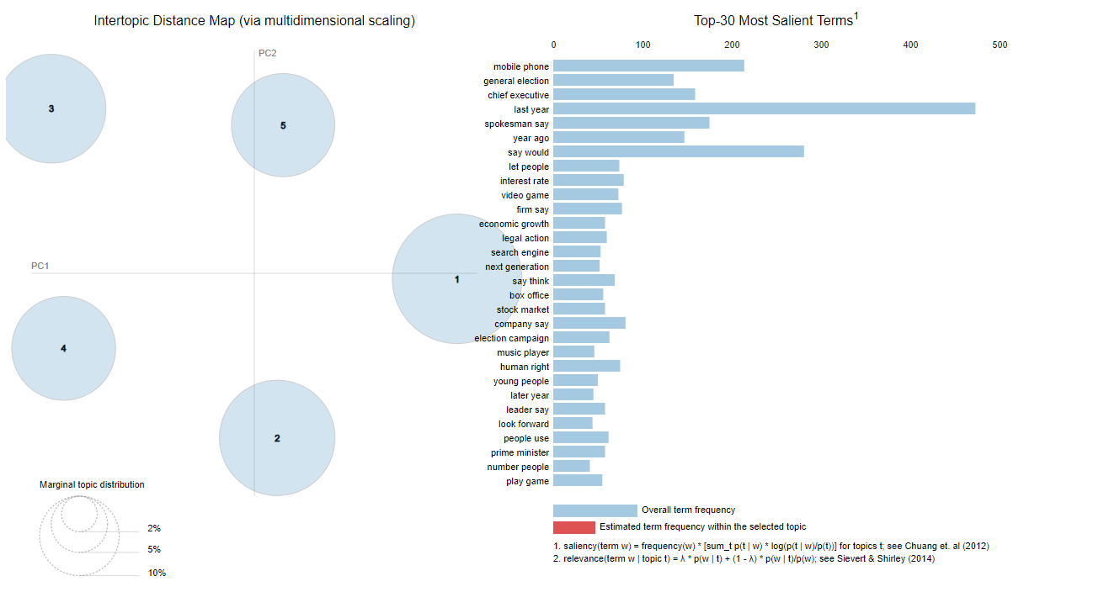
Latent Dirichilet Allocation

Slide 16
Similar Words
Word : Film Word:Price Word:Stock
Good
Award
Star
Play
Actor
Rate
Rise
High
Profit
Fall
Gross
Soar
Copy
Late
Monthly

Slide 17
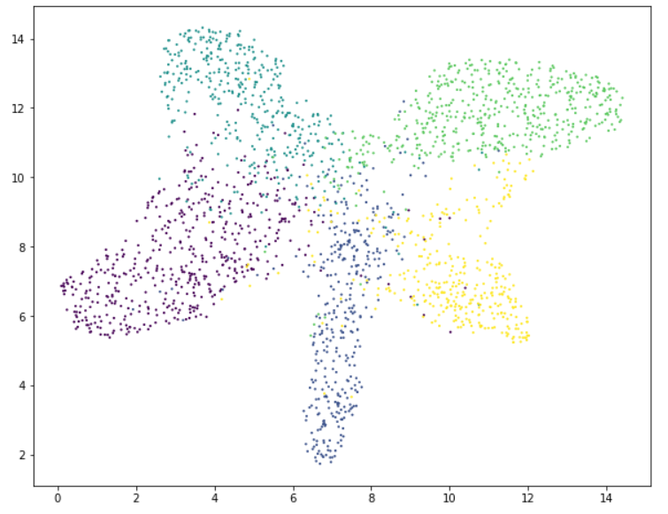
Latent Semantic Analysis

Slide 18
Challenges
Text Preprocessing
Limited visualization techniques

Slide 19
Conclusion
In Latent Dirichilet Allocation(LDA) with TF-IDF vectorizer we find best clustering for our news article dataset .
Using of genism we can find a similar words .
As a future we can implement topic modeling using different techniques like neural network.

Slide 20
Q & A

Slide 21
Thank You

